Slide 1

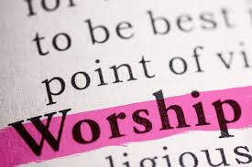
“We make no melody unless we sing with grace in our hearts.”
Matthew Henry

Slide 2
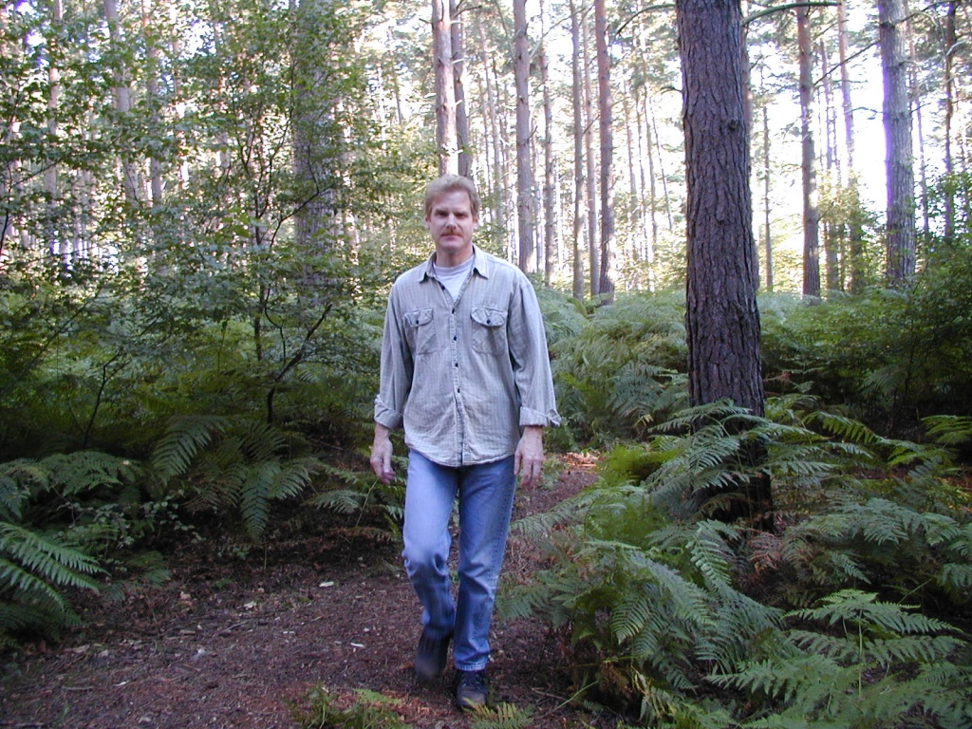
My Personal Worship Journey

Slide 3

Purpose of Worship
What is God’s desired outcome for worship?
What is our desired outcome? Do they sometimes differ? Why?
Mechanisms of worship - How do we do it?

Slide 4
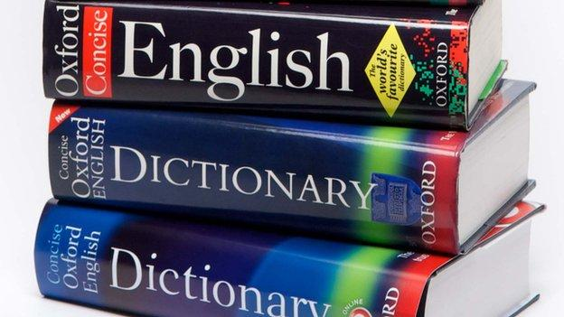
Common definition of worship – “worthy ship”
1958 Dictionary – Courtesy or reverence paid to worth; hence honor, respect
2022 Dictionary – To honor or show reverence for a divine being or supernatural power
Holding as holy because of the character of the one worshipped; homage (ceremony)
Synonyms – adore, respect, revere, deify, glorify, adulate, venerate

Slide 5
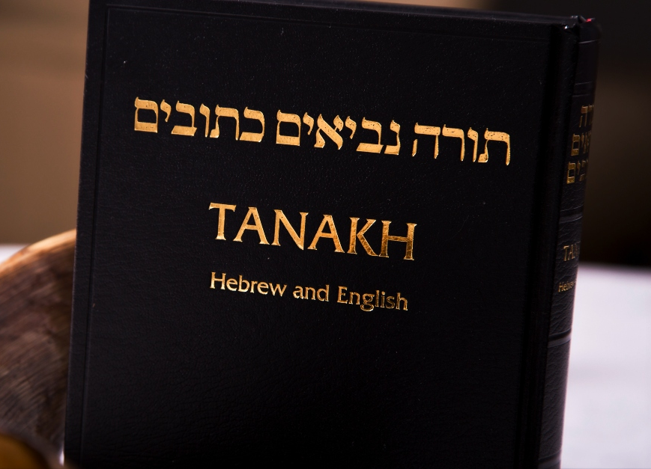
Hebrew words for worship
1. Hallel - to shine, to be boastful, to glorify
The root gives us Hallelujah – praise + YHWH
II Sam 6:14 – David danced before the Lord
Psa 113:1 – Praise (hallelu) ye the Lord.
2. Tehilah – a praise song
Hebrew name for the book of Psalms
An instruction to bring forth light with songs, shouts and holy noise
Ex 15:2 – Just after God delivers them from the Egyptians
Ps 22:3 – You inhabit the praises of Israel.
https://firmisrael.org/learn/praise-and-worship-in-hebrew-6-words-to-know/

Slide 6
Hebrew words for worship (cont)
3. Zamar – musical term for praise
The use of stringed instruments ( Seven Psalms contain the instruction to use)
Implies a collective harmony
An atmosphere where God is invited to move
Rev 5:8, 14:2, 15:2, 18:22 – the sound of harpists
I Sam 16:23 - David played the lyre and the evil spirit would leave Saul
4. Yadah – Rare use - moments when God is praised by raising of hands
Ex 17 – raising of hands meant a battle
When we surrender ourselves, God can fight the battle

Slide 7
Hebrew words for worship (cont)
5. Todah – simply saying thank you
Psa 56:12 – I will render praises unto Thee
6. Barach – indicates the physical posture of kneeling
Abandon physical comfort in order to pay homage
I Kings 18:42 – Elijah kneeling when praying for rain
Ex 3 – Moses at the burning bush

Slide 8
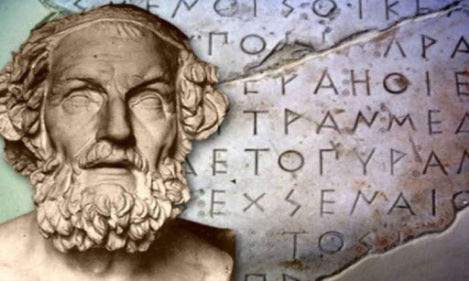
Greek words for worship
1. Proskuneo - to prostrate, bow down
Most prominent in the N.T. (59 times) and closest to English word for worship
Never used as a synonym for a meeting
Rev 14:7 - worship him who made heaven and earth
Rev 7:11 - And all the angels were standing around the throne and around the elders and the four living creatures, and they fell on their faces before the throne and worshiped God
2. Latreuo – to serve in a priestly or sacrificial manner
Some controversy around this word - Romans 12:1 - Is all of life worship?
Heb 12:28 “and thus let us offer to God acceptable worship, with reverence and awe”
Acts 7:7 - they shall come out and worship me in this place.’
https://godsbreath.net/2015/03/05/greek-words-for-worship-in-the-bible/

Slide 9
Greek words for worship (cont)
3. Leitourgeo – liturgy - to minister in an official manner
Broader in definition than the previous 2 above
Perhaps better translated as “to minister”
Hebrews 9:21 - And in the same way he sprinkled with the blood both the tent and all the vessels used in worship.
4. Threiskeia – religious service or cult
More of a reference to a belief system rather than an action
James 1:26,27 – “If anyone thinks himself to be religious… this is pure and undefiled religion”

Slide 10
Greek words for worship (cont)
5. Sebomai – to venerate (reverence and respect)
Almost all of the times this refers to worship of pagans or vain worship of God
Acts 19:27 – worship of a pagan deity
Rom 1:25 – worship of the creation/creature rather than the Creator
6. Eusebio – to show respect – piety, loyalty
Not just the attitude but also the activity
Titus 2:12 - the grace of God teaches us to reject ungodliness and worldly (immoral) desires, and to live sensible, upright, and godly lives [lives with a purpose that reflect spiritual maturity] in this present age

Slide 11

Key Passages on Worship
Jn 4:23,24
True worshippers will worship in Spirit and in Truth
Spirit – a current of air, breath, breeze, mental disposition, superhuman, divine
Truth – not concealing

Slide 12
Key Passages on Worship
Colossians 3:16
Psalms – a sacred song or poem meaning to shine or flash forth light accompanied with the voice, harp, or other instrument
C.S Lewis - “The most valuable thing the Psalms do for me is to express the same delight in God which made David dance.”
Hymns – word form comes from “to celebrate”.
      A religious song or metrical composition of praise to God. Different from a psalm – songs created by a human
Spiritual songs – a chant or ode, general term for any words sung

Slide 13
Key Passages on Worship
I Chronicles 25:1-8
1 David and the chiefs of the service also set apart for the service the sons of Asaph, and of Heman, and of Jeduthun, who prophesied with lyres, with harps, and with cymbals. The list of those who did the work and of their duties was: 2 Of the sons of Asaph: Zaccur, Joseph, Nethaniah, and Asharelah, sons of Asaph, under the direction of Asaph, who prophesied under the direction of the king. 3 Of Jeduthun, the sons of Jeduthun: Gedaliah, Zeri, Jeshaiah, Shimei, Hashabiah, and Mattithiah, six, under the direction of their father Jeduthun, who prophesied with the lyre in thanksgiving and praise to the Lord. 4 Of Heman, the sons of Heman: Bukkiah, Mattaniah, Uzziel, Shebuel and Jerimoth, Hananiah, Hanani, Eliathah, Giddalti, and Romamti-ezer, Joshbekashah, Mallothi, Hothir, Mahazioth. 5 All these were the sons of Heman the king's seer, according to the promise of God to exalt him, for God had given Heman fourteen sons and three daughters. 6 They were all under the direction of their father in the music in the house of the Lord with cymbals, harps, and lyres for the service of the house of God. Asaph, Jeduthun, and Heman were under the order of the king. 7 The number of them along with their brothers, who were trained in singing to the Lord, all who were skillful, was 288. 8 And they cast lots for their duties, small and great, teacher and pupil alike.

Slide 14
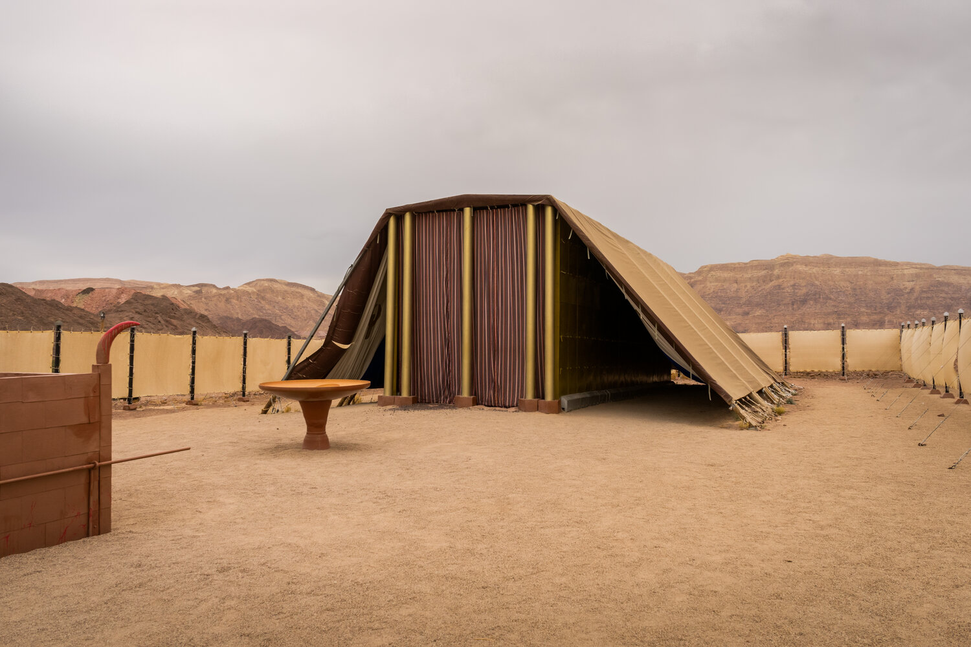
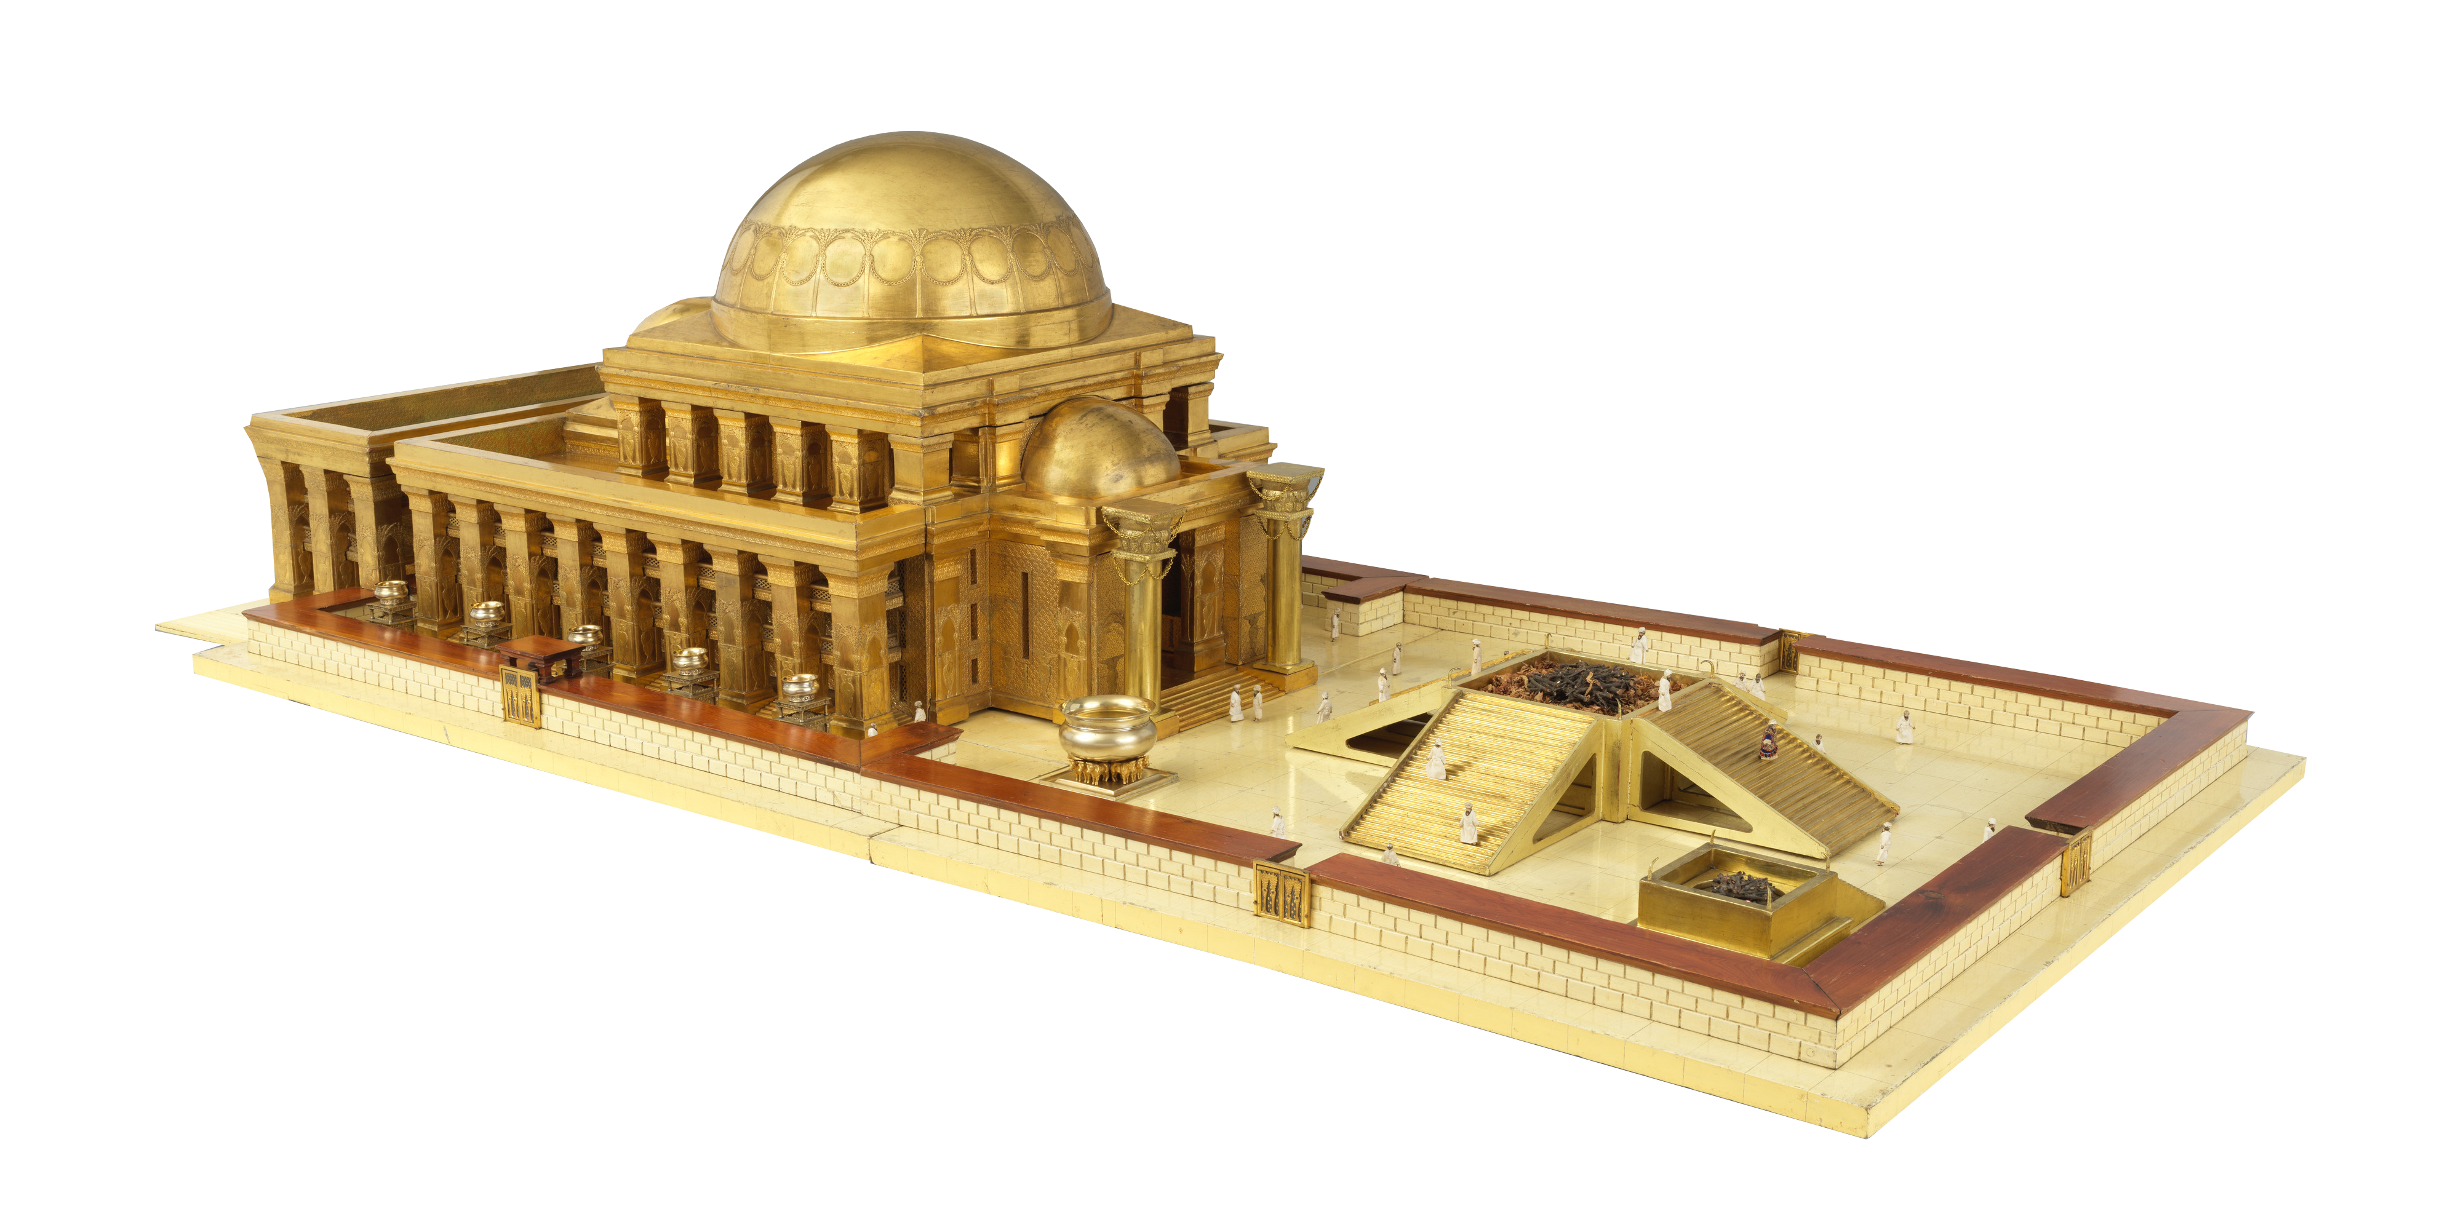
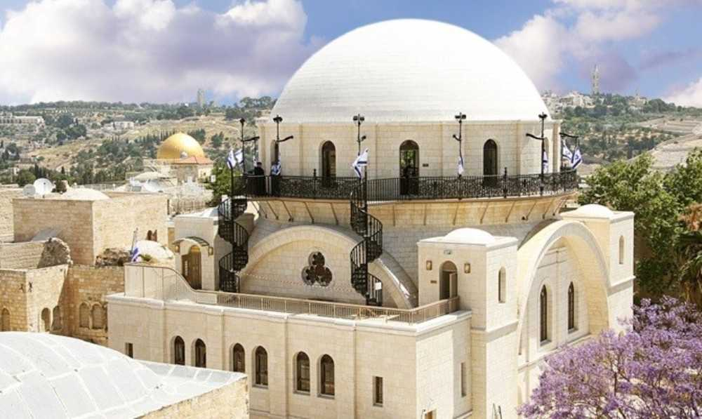
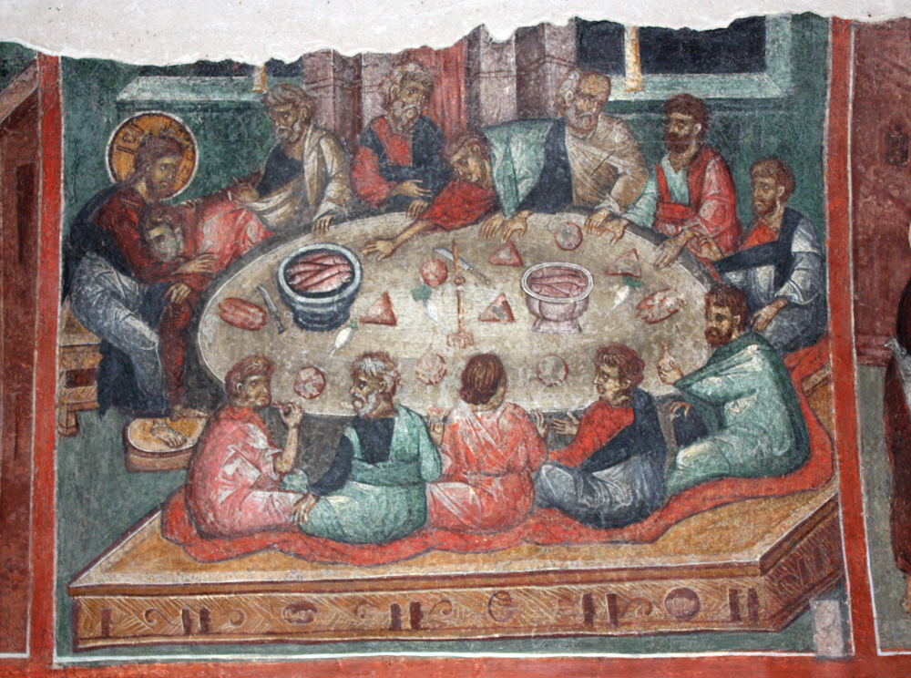
Four Stages of Development of Public Worship
Before building of the Temple
No fine line between public and private worship
Temple Ritual
Highly organized, led by priests, assisted by Levites
System of sacrifices centralized in Jerusalem
Synagogue – during the exile
Wherever there were Jews
Emphasis on instruction rather than worship
Early Christian Churches
Along the lines of the synagogue
Met in homes i.e whereever there were believers
Preaching, reading of the word, prayer, singing, baptism, Lord’s supper, giving

Slide 15
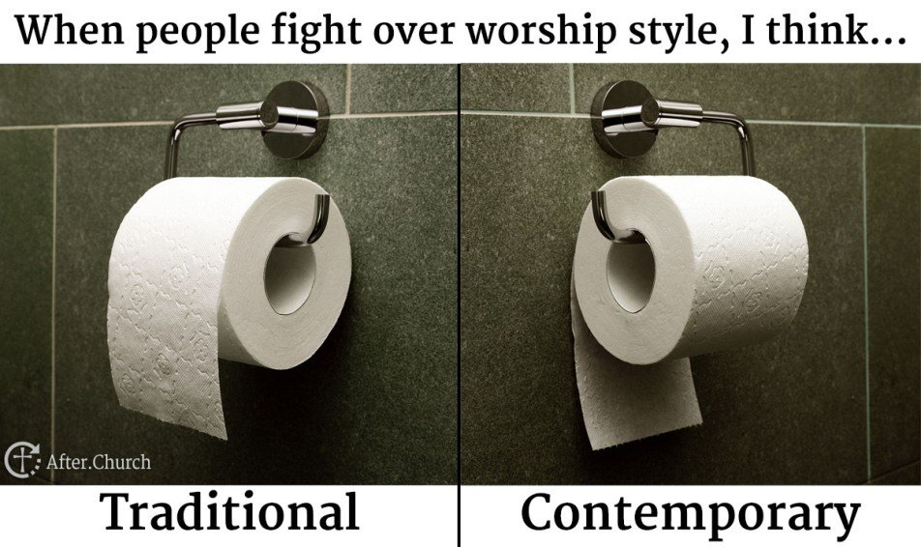
Worship Styles
Traditional (piano, organ, classical instruments)
Pro – Strong theological content, familiarity, memories
Con – get lost in the liturgy, rote, not accessible to most people
under 50
Choruses or blended (piano, acoustic guitars, bass, drums)
Pro – can be very worshipful and heartfelt
Con – repetitive, shallow
Contemporary (acoustic, electric or mixed)
Pro – New songs can help us rethink, our minds are more engaged, more attractive to our culture and/or younger people
Con – performance rather than group worship, sometimes me-focused, not always sound theology
C.S. Lewis - “The perfect church service would be the one we were almost unaware of; our attention would have been on God. But every novelty prevents this. It fixes our attention on the service itself; and thinking about worship is a different thing than worshipping ... 'Tis mad idolatry that makes the service greater than the god.“

Slide 16
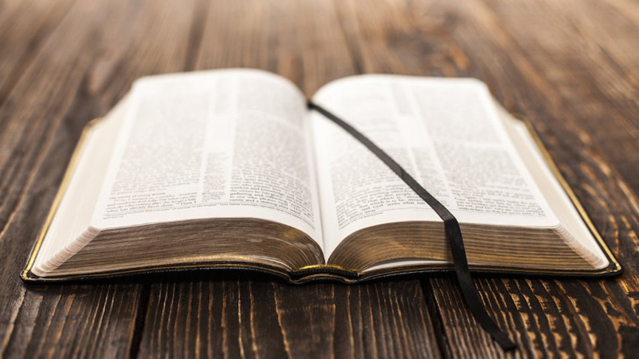
Conclusion
I Chronicles 16:7-19
7 That day David first appointed Asaph and his associates to give praise to the LORD in this manner:8 Give praise to the LORD, proclaim his name; make known among the nations what he has done. 9 Sing to him, sing praise to him; tell of all his wonderful acts.10 Glory in his holy name; let the hearts of those who seek the LORD rejoice.11 Look to the LORD and his strength; seek his face always.12 Remember the wonders he has done, his miracles, and the judgments he pronounced, 13 you his servants, the descendants of Israel, his chosen ones, the children of Jacob. 14 He is the LORD our God; his judgments are in all the earth.15 He remembers his covenant forever, the promise he made, for a thousand generations,16 the covenant he made with Abraham, the oath he swore to Isaac. 17 He confirmed it to Jacob as a decree, to Israel as an everlasting covenant: 18 “To you I will give the land of Canaan as the portion you will inherit.”When they were but few in number, few indeed, and strangers in it, 20 they wandered from nation to nation, from 19 one kingdom to another.

Slide 17
Conclusion
I Chronicles 16:21-36
21 He allowed no one to oppress them; for their sake he rebuked kings: 22 “Do not touch my anointed ones; do my prophets no harm.”23 Sing to the LORD, all the earth; proclaim his salvation day after day.24 Declare his glory among the nations, his marvelous deeds among all peoples.25 For great is the LORD and most worthy of praise; he is to be feared above all gods.26 For all the gods of the nations are idols, but the LORD made the heavens.27 Splendor and majesty are before him; strength and joy are in his dwelling place.28 Ascribe to the LORD, all you families of nations, ascribe to the LORD glory and strength.29 Ascribe to the LORD the glory due his name; bring an offering and come before him. Worship the LORD in the splendor of his holiness.30 Tremble before him, all the earth! The world is firmly established; it cannot be moved.31 Let the heavens rejoice, let the earth be glad; let them say among the nations, “The LORD reigns!”32 Let the sea resound, and all that is in it; let the fields be jubilant, and everything in them!33 Let the trees of the forest sing, let them sing for joy before the LORD, for he comes to judge the earth.34 Give thanks to the LORD, for he is good; his love endures forever.35 Cry out, “Save us, God our Savior; gather us and deliver us from the nations, that we may give thanks to your holy name, and glory in your praise.”36 Praise be to the LORD, the God of Israel, from everlasting to everlasting. Then all the people said “Amen” and “Praise the LORD.”

Slide 18

QUESTIONS?

